Slide 1
Controller design
Presentation Exercise 2:
Baseline Torque controller

Slide 2
1 – Design of a Baseline Torque Controller
b) Parameter determination for baseline controller:
• Parameter.VSC.k
• Parameter.VSC.M_g_rated
• Parameter.VSC.a_1_5
• Parameter.VSC.b_1_5
• Parameter.VSC.a_2_5
• Parameter.VSC.b_2_5
Calculation in the Exercise02_TorqueControllerDesign.m file and implementation for the simulation in the NREL5MWDefaultParameter_FBNREL_TorqueController.m

Slide 3
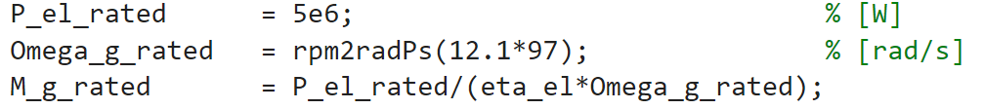
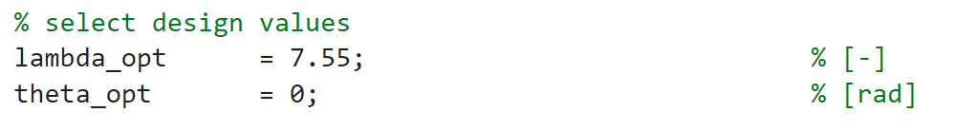


1 – Design of a Baseline Torque Controller
b) Parameter determination for baseline controller:
• Parameter.VSC.M_g_rated
$$=43093.6 Nm$$
• Parameter.VSC.k
$$=2.32318 [−]$$

Slide 4
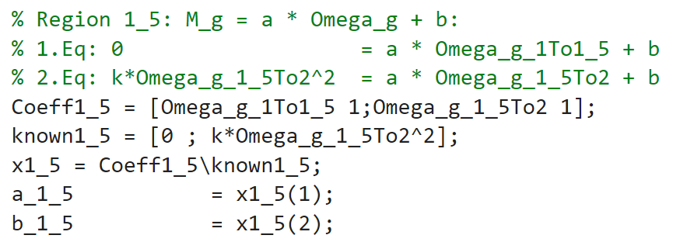
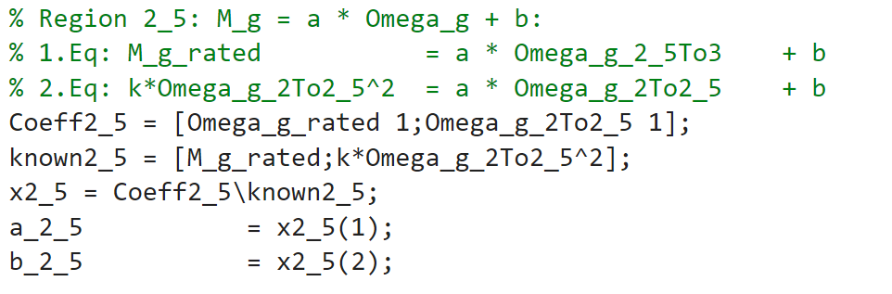




1 – Design of a Baseline Torque Controller
b) Parameter determination for baseline controller:
• Parameter.VSC.a_1_5
• Parameter.VSC.b_1_5
$$= 918.23$$
$$=-64425.1$$
• Parameter.VSC.a_2_5
• Parameter.VSC.b_2_5
$$=3915.26$$
$$=\text{-438130}$$

Slide 5
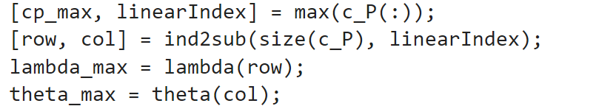
1 – Design of a Baseline Torque Controller
c) Calculate $λ$ and $θ$ to reach a higher value of $c_{p}$
We calculate, for a reference value of $c_{p}$ the maximum value that we can find in the $c_{p}$ matrix:
We calculate, then, the additional power for the turbine for this new power coefficient as a percentage

Slide 6
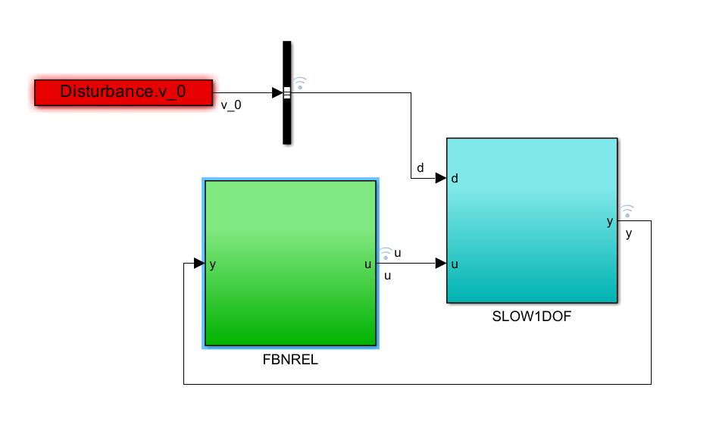
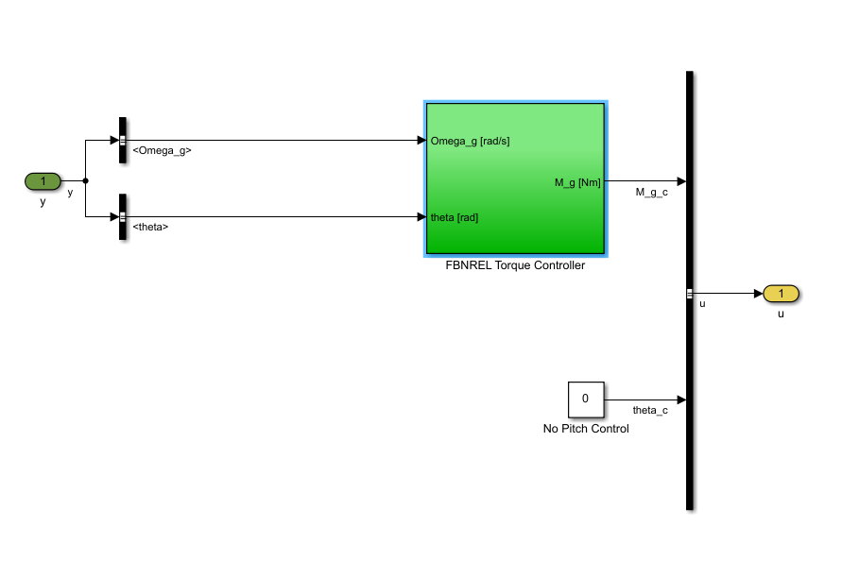
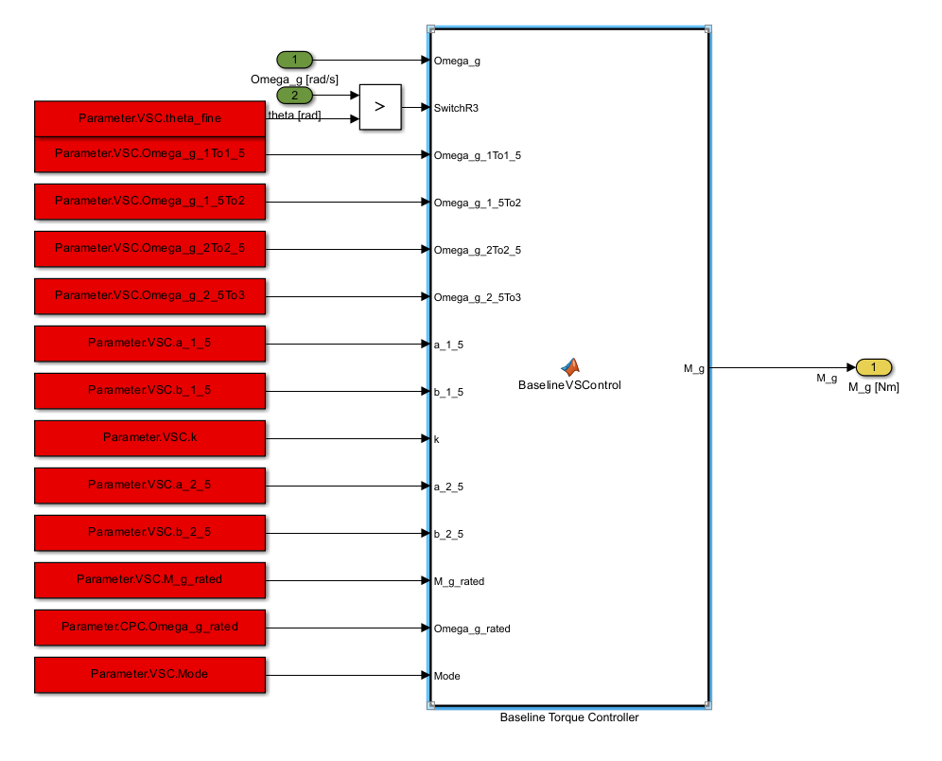
1 – Design of a Baseline Torque Controller
d) Implementation of the function inside of the baseline controller inside of the Simulink structure

Slide 7
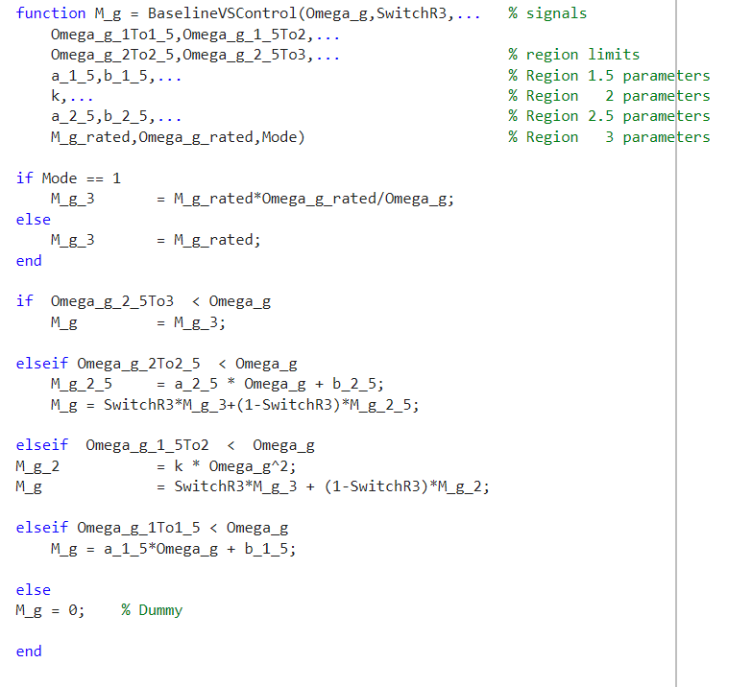
1 – Design of a Baseline Torque Controller
d) Implementation of the function inside of the baseline controller inside of the Simulink structure
Region 3
Region 2.5
Region 2
Region 1.5
Region 1

Slide 8

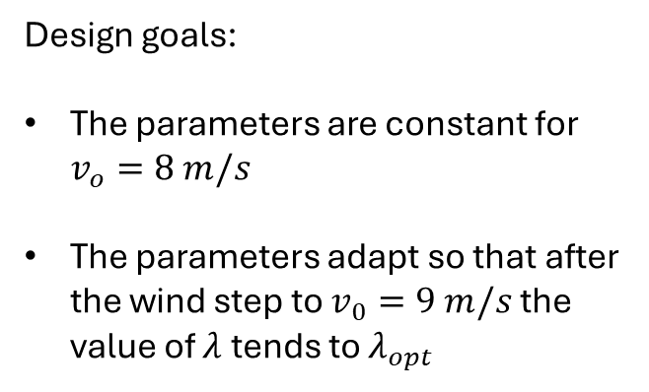
1 – Design of a Baseline Torque Controller
e) Does the torque controller fulfill the design goal?
Design goals:
The parameters are constant for $v_{o}=8 m/s$
The parameters adapt so that after the wind step to $v_{0}=9 m/s$ the value of $λ$tends to $λ_{opt}$

Slide 9
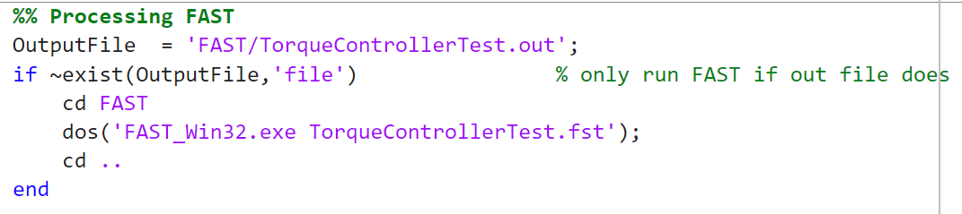
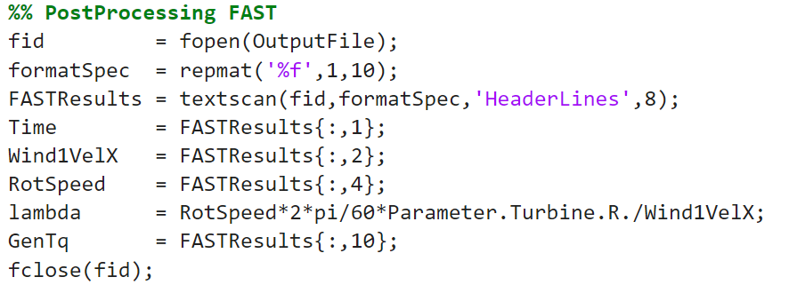
2 – Test of a Baseline controller
a) Comparison with FAST: FAST implementation on MATLAB:
Processing
Post Processing

Slide 10
2 – Test of a Baseline controller
b) Comparison with FAST: comparison with fast
How do model uncertainties impact the behavior?
The initial oscillations for the FAST model are probably due to the adaptation of the model to the wind characteristics but for the rest the two models are following almost the same trend.
The only part that changes and, for which, the adaptation by FAST is not as smooth as the one for SLOW (which is very simplified) is the time period after the time step.
It takes a few seconds for the FAST model to adapt to the SLOW smooth curve

